Slide 1





Understanding and Finding System Setting-Related Defects in Android Apps
Jingling Sun, Ting Su, Junxin Li, Zhen Dong,
Geguang Pu, Tao Xie, Zhendong Su

Slide 2

BACKGROUND
Worldwide Smartphone Shipment OS Market Share in 2021

Slide 3



























BACKGROUND
Apps and notifications
Battery
Location and security
Accessibility
Developer
Sound
Display
Network and connect
Other

Slide 4


BACKGROUND
Apps and notifications
Battery
Location and security
Accessibility
Developer
Sound
Display
Network and connect
Other

Slide 5
BACKGROUND

Slide 6
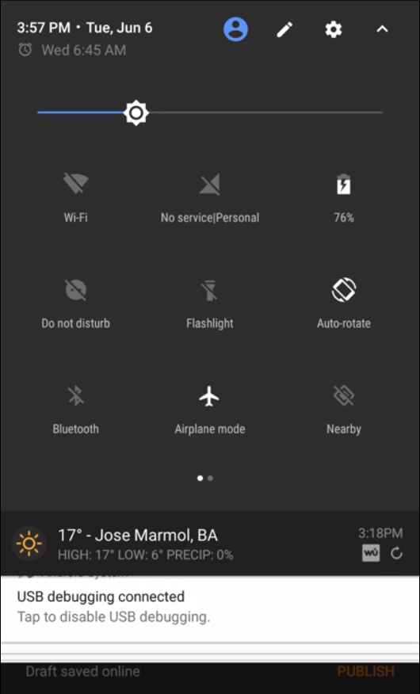
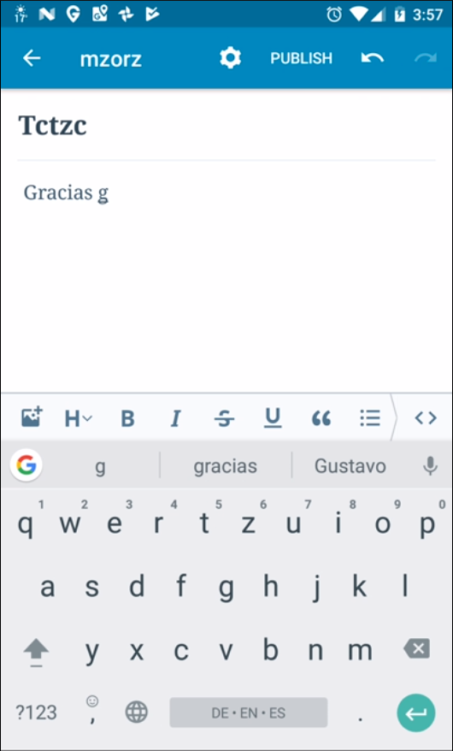
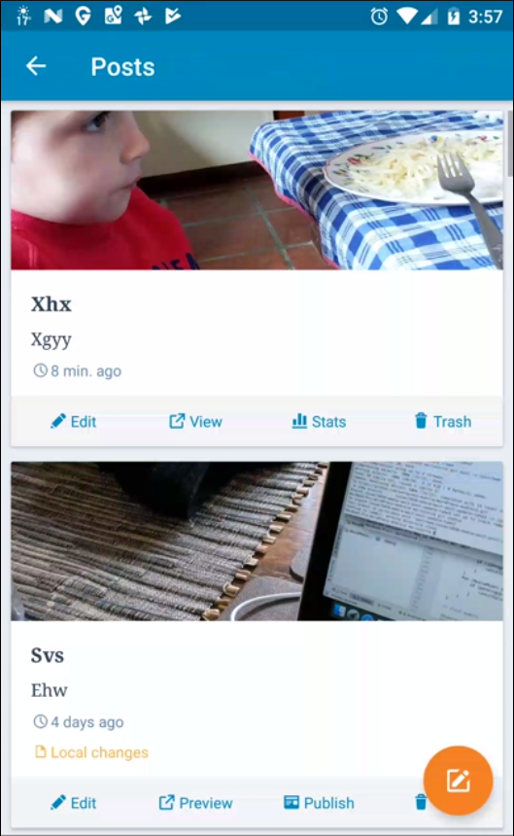
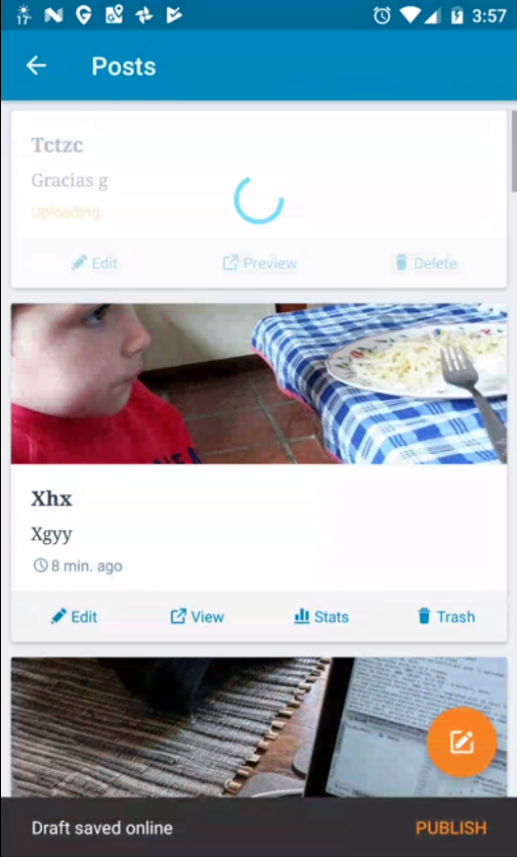
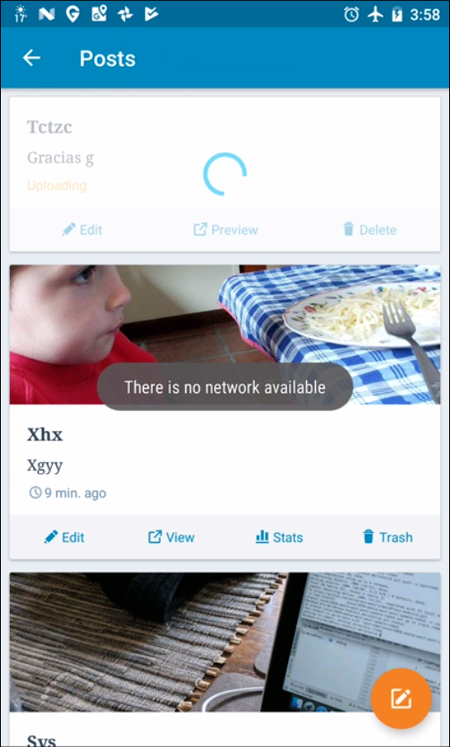
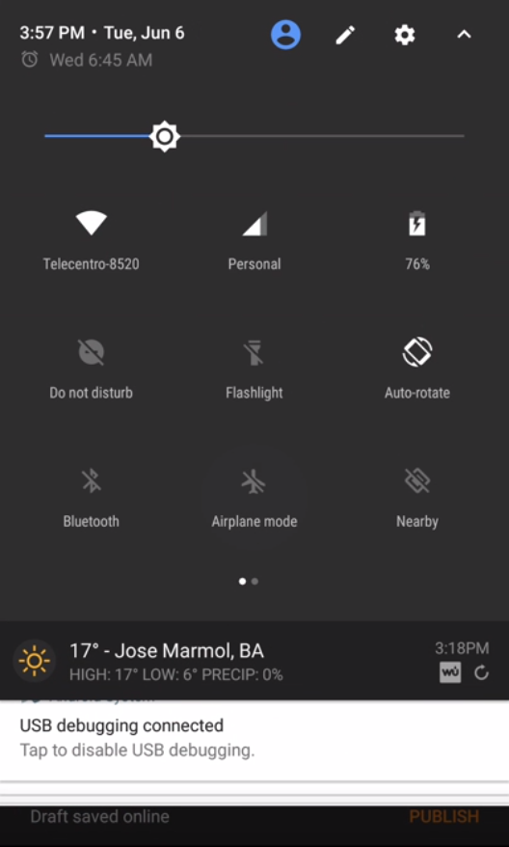
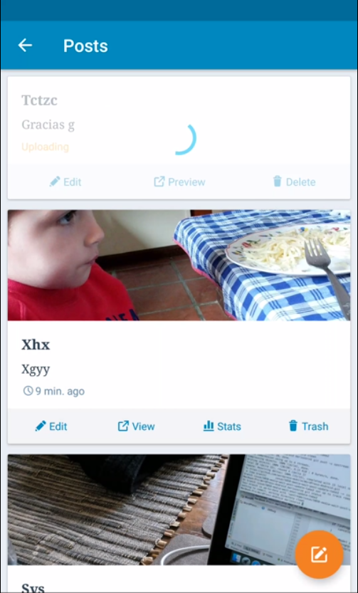


A REAL SETTING defect
10,000,000+ installations on Google Play
2.5K stars on GitHub

Slide 7
EMPIRICAL STUDY
We conducted the first systematic study to understand the characteristics of setting defects in Android apps.

Slide 8
RESEARCH QUESTIONS
RQ1
Do settings defects have a wide impact on the correctness of apps in the wild?
RQ2
What are their major root causes?
RQ3
What are their common consequences? How do they manifest?

Slide 9





EMPIRICAL STUDY
Summarizing
keywords
Android documentation
Setting keywords
Collecting and validating defects
Analysis
1,074 setting defects
Crawling
apps
180 popular
Android apps
GitHub
3 person-months effort

Slide 10
IMPACT
Statistics of the impact of setting defects on the 180 apps
162
1,074
⇒ 90% (162/180) of apps were ever affected by setting defects.

Slide 11
RQ2: ROOT CAUSE
Root causes of 482 fixed setting defects
#Bug reports
⇒ Incorrect callback implementations, lack of setting checks and fail to adapt user interfaces are responsible for 85.1% of setting defects.

Slide 12
RQ2: ROOT CAUSE
Incorrect callback implementations
Root causes of 482 fixed setting defects
#Bug reports

Slide 13
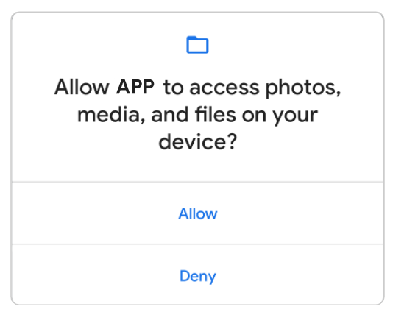
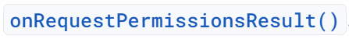
RQ2: ROOT CAUSE
Incorrect callback implementations

Slide 14
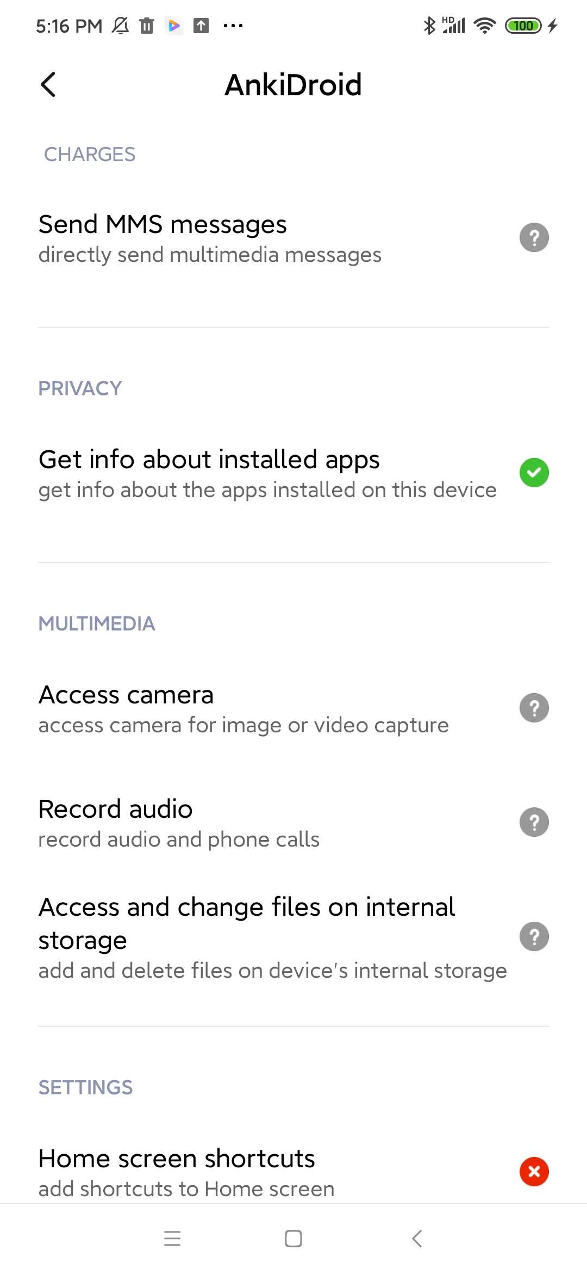
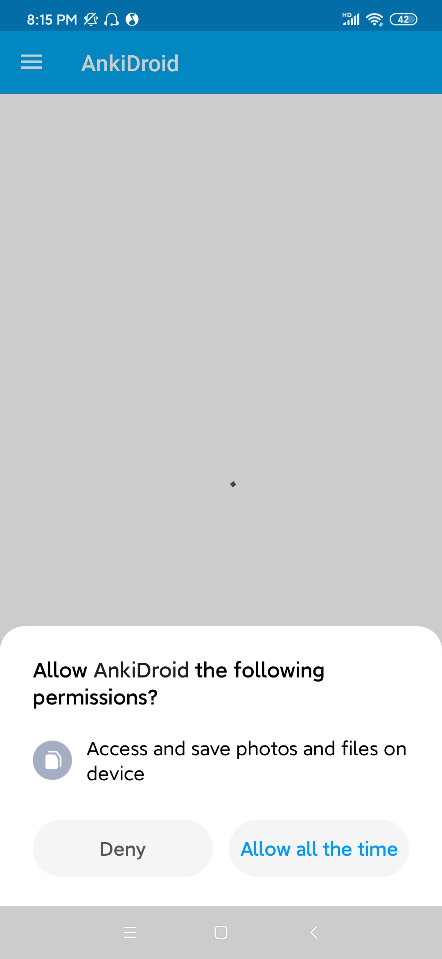
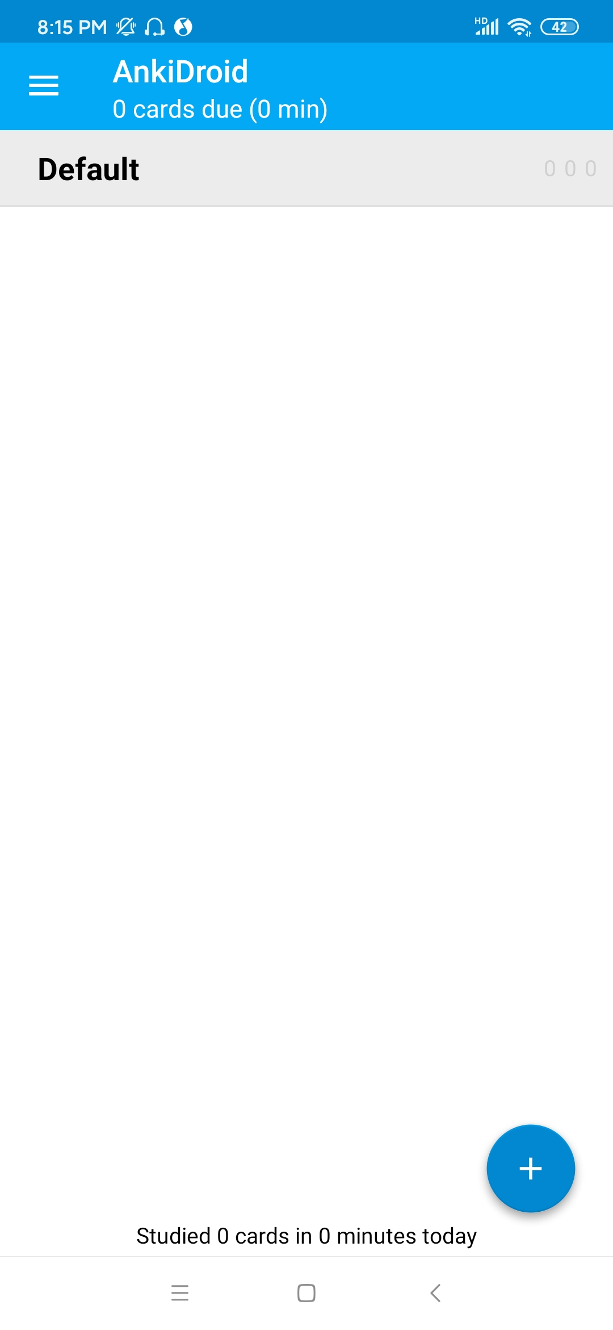
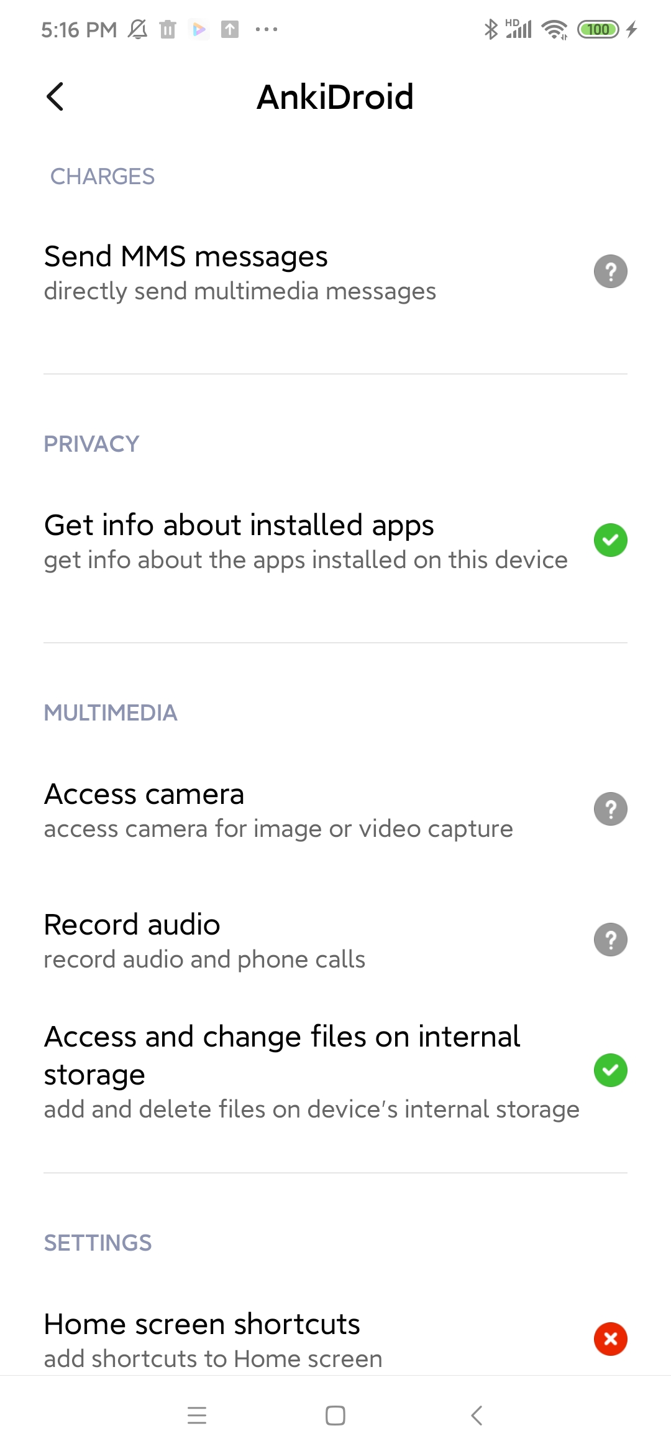
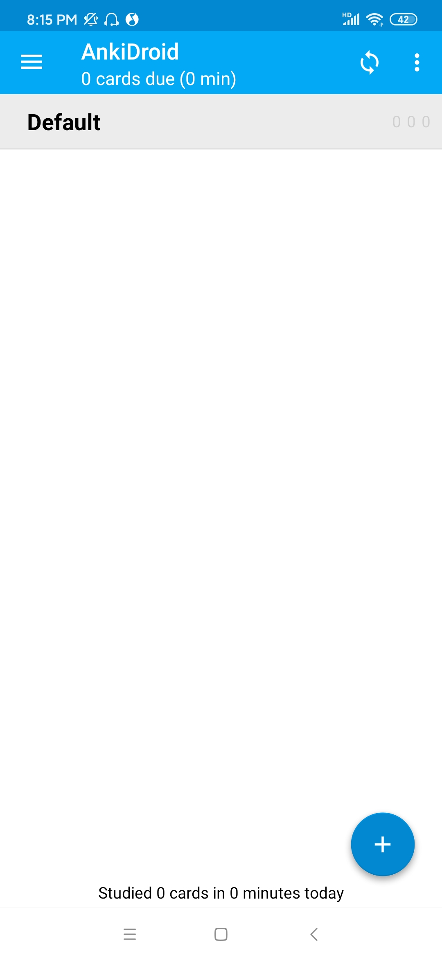
RQ2: ROOT CAUSE
Incorrect callback implementations

Slide 15
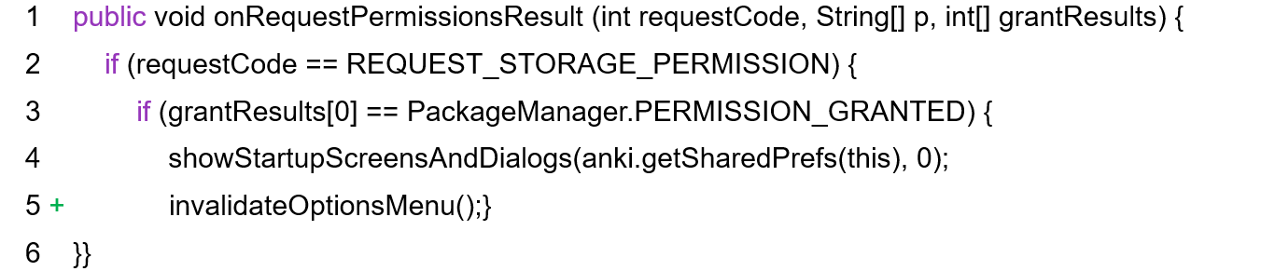
RQ2: ROOT CAUSE
Incorrect callback implementations

Slide 16
RQ2: ROOT CAUSE
Lack of setting checks
Root causes of 482 fixed setting defects
#Bug reports

Slide 17
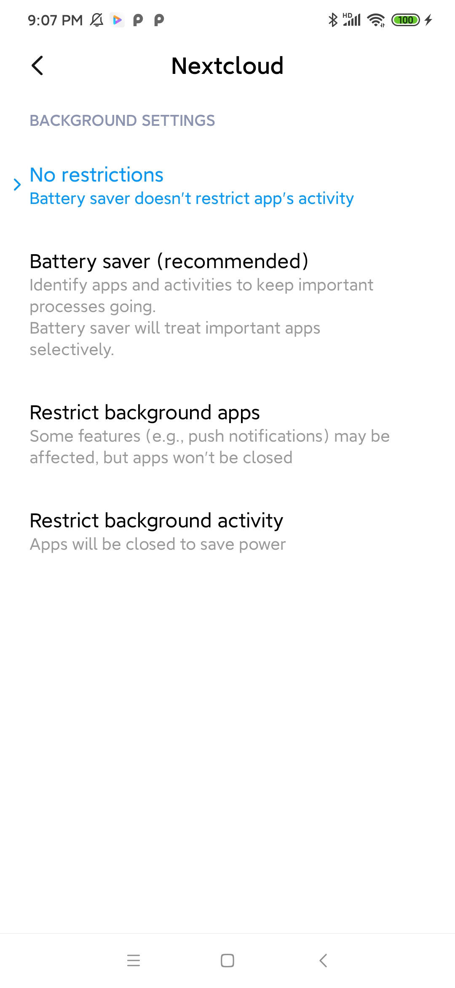
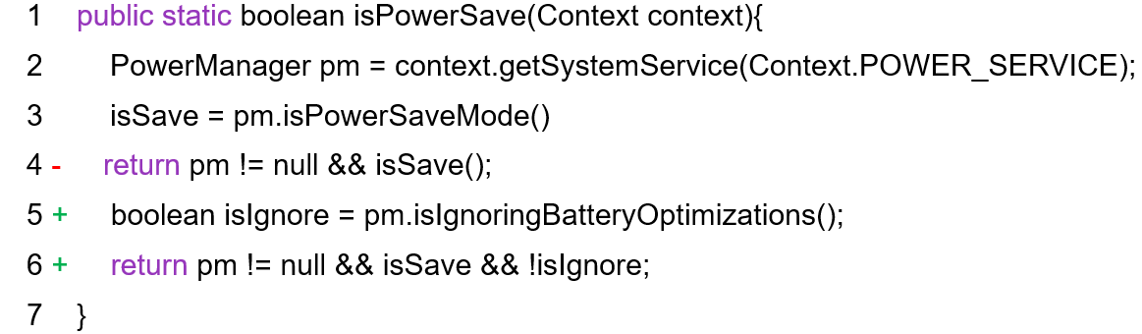
RQ2: ROOT CAUSE
Lack of setting checks

Slide 18
RQ2: ROOT CAUSE
Fail to adapt user interfaces
Root causes of 482 fixed setting defects
#Bug reports

Slide 19
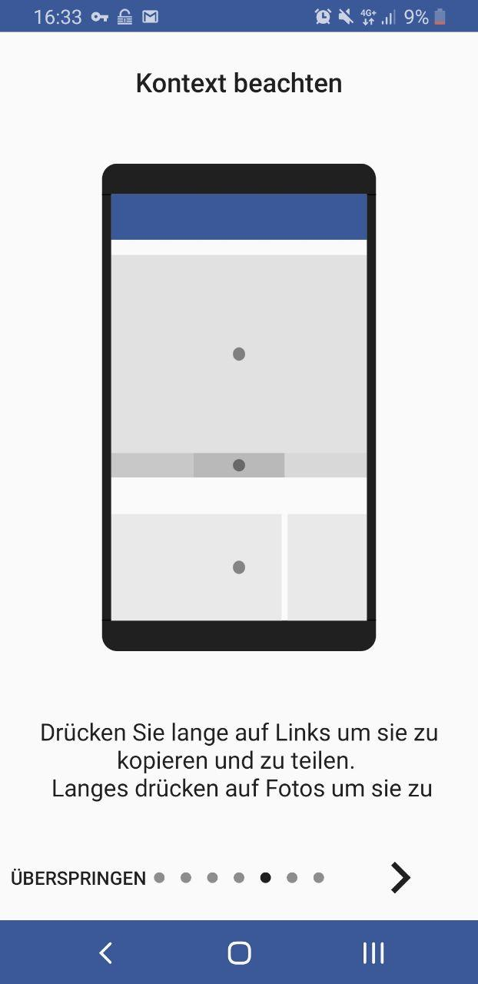
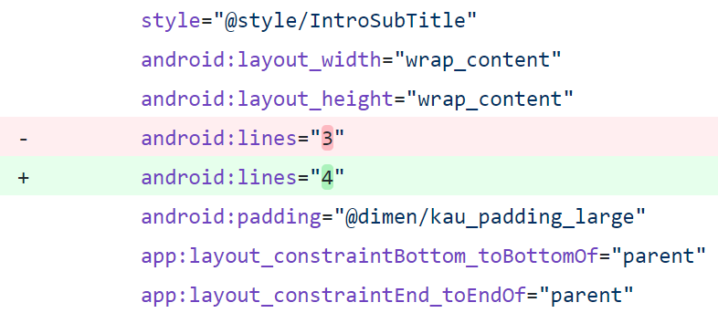
RQ2: ROOT CAUSE
Fail to adapt user interfaces

Slide 20
RQ2: ROOT CAUSE
Lack of Considering Android Versions
Root causes of 482 fixed setting defects
#Bug reports

Slide 21
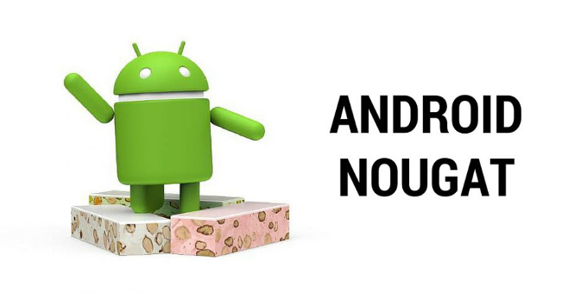


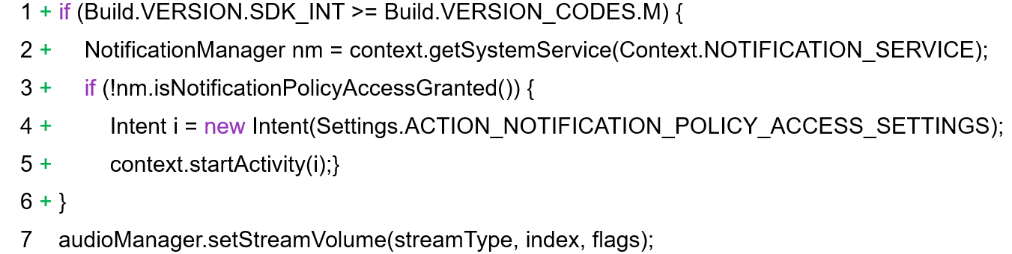
RQ2: ROOT CAUSE
Lack of Considering Android Versions

Slide 22
RQ2: ROOT CAUSE
Mutual Influence Between Settings
Root causes of 482 fixed setting defects
#Bug reports

Slide 23
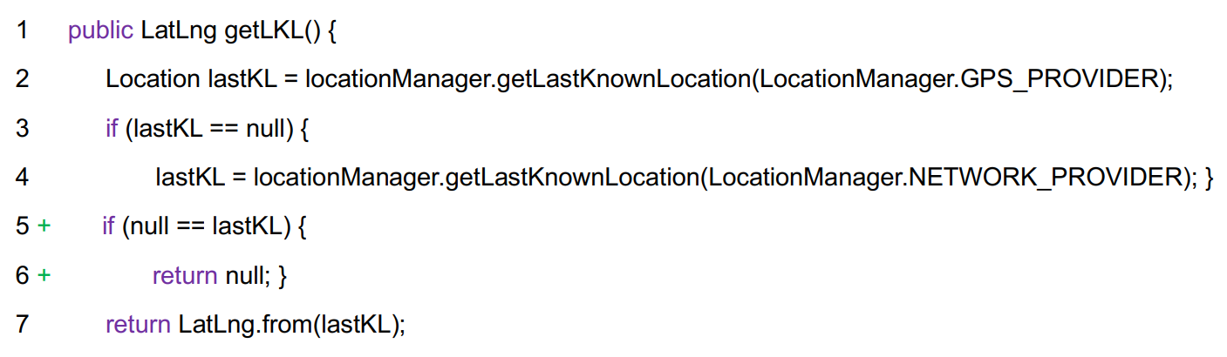
RQ2: ROOT CAUSE
Mutual Influence Between Settings
location.getLatitude()

Slide 24
CONSEQUENCES
Consequences of 1,074 setting defects
70.7%
#Bug reports
⇒ 70.7% of setting defects are non-crashing bugs and only manifest as GUI defects

Slide 25
RELATED WORK
Constrain the testing within the app
(APE [ICSE’19], Stoat [FSE’17], ……)
Existing automated testing tools for Android:
Focus on limited types of settings
(PATDroid [FSE’17], Prefest [FSE’19], ……)
All are limited to detecting crash bugs due to the lack of test oracles
permission
connect and location
⇒ 70.7% of the setting defects (which are non-crashing bugs) cannot be automatically detected by prior testing techniques.

Slide 26
OUR APPROACH
Setting-wise metamorphic fuzzing,
the first fully automated testing technique to overcome the oracle problem in detecting setting defects.

Slide 27


OUR APPROACH
Metamorphic testing is a property-based software testing approach to addressing the test oracle problem. The key is to find the metamorphic relations, the necessary properties of the intended functionality of the software.
The metamorphic relations in our case are:
The app behaviors should keep consistent if a given setting is changed and later properly restored, or show expected differences if not restored.

Slide 28
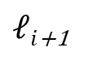
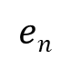
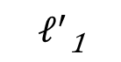
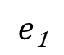
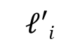
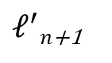

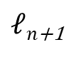
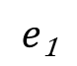
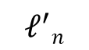


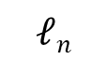
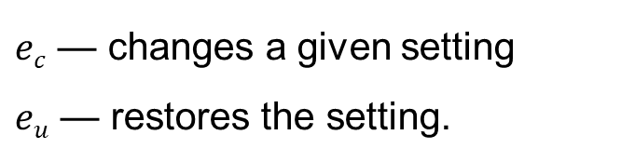
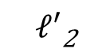


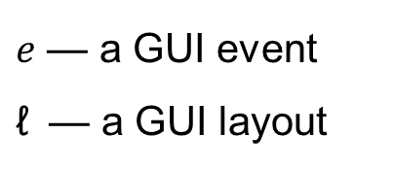
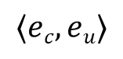

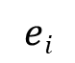
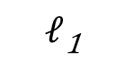
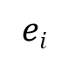
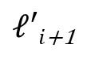
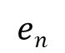
OUR APPROACH
$$e\text{1}$$
$$ei$$
$$……$$
$$en$$
Seed test trace:
$ℓ$₁
$$ℓ\text{2}$$
$$……$$
$$ℓi$$
$ℓi$₊₁
$$ℓn$$
$ℓn$₊₁
$$e\text{1}$$
$$……$$
$$ei$$
$$……$$
$$en$$
Mutant test trace:
$$ℓ^{′}\text{1}$$
$$ℓ′\text{2}$$
$$ℓ′i$$
$ℓ′i$₊₁
$$ℓ^{′}n$$
$ℓ^{′}n$₊₁
$$⟨ec,eu⟩$$
$\text{e}$ — a GUI event
$\text{ℓ}$ — a GUI layout
$ec$ — changes a given setting
$eu$ — restores the setting.

Slide 29
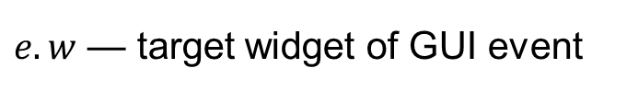
OUR APPROACH
$$e\text{1}$$
$$ei$$
$$……$$
$$en$$
Seed test trace:
$ℓ$₁
$$ℓ\text{2}$$
$$……$$
$$ℓi$$
$ℓi$₊₁
$$ℓn$$
$ℓn$₊₁
Compare the GUI consistency
$$e\text{1}$$
$$……$$
$$ei$$
$$……$$
$$en$$
Mutant test trace:
$$ℓ^{′}\text{1}$$
$$ℓ′\text{2}$$
$$ℓ′i$$
$ℓ′i$₊₁
$$ℓ^{′}n$$
$ℓ^{′}n$₊₁
$$⟨ec,eu⟩$$
$\text{e}$ — a GUI event
$\text{ℓ}$ — a GUI layout
$ec$ — changes a given setting
$eu$ — restores the setting.
$\text{e}.w$ — target widget of GUI event

Slide 30

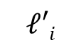
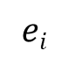



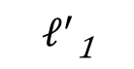
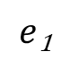
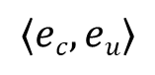
Oracle checking rule I
OUR APPROACH
$$e\text{1}$$
$$ei$$
$$……$$
$$en$$
Seed test trace:
$ℓ$₁
$$ℓ\text{2}$$
$$……$$
$$ℓi$$
$ℓi$₊₁
$$ℓn$$
$ℓn$₊₁
Check whether $e_{i}.w$in both ℓ𝑖 and ℓ′𝑖
$$e\text{1}$$
$$……$$
$$ei$$
Mutant test trace
(w/ setting issue):
$$ℓ^{′}\text{1}$$
$$ℓ′\text{2}$$
$$ℓ′i$$
$${{∃e}_{i}.e}_{i}.w∈ℓi{∧e}_{i}.w∉ℓ′i$$
$$⟨ec,eu⟩$$
$\text{e}$ — a GUI event
$\text{ℓ}$ — a GUI layout
$ec$ — changes a given setting
$eu$ — restores the setting.
$\text{e}.w$ — target widget of GUI event

Slide 31
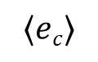
Oracle checking rule II
OUR APPROACH
$$e\text{1}$$
$$ei$$
$$……$$
$$en$$
Seed test trace:
$ℓ$₁
$$ℓ\text{2}$$
$$……$$
$$ℓi$$
$ℓi$₊₁
$$ℓn$$
$ℓn$₊₁
Check the text of ℓ𝑖 and ℓ′𝑖
$$e\text{1}$$
$$……$$
$$ei$$
$$……$$
$$en$$
Mutant test trace:
$$ℓ^{′}\text{1}$$
$$ℓ′\text{2}$$
$$ℓ′i$$
$ℓ′i$₊₁
$$ℓ^{′}n$$
$ℓ^{′}n$₊₁
$$⟨ec⟩$$
$\text{e}$ — a GUI event
$\text{ℓ}$ — a GUI layout
$ec$ — changes a given setting
$eu$ — restores the setting.
$\text{e}.w$ — target widget of GUI event

Slide 32
SETDROID
List of pairs of events for setting changes
Setting | Oracle Rule | Pair of events for setting changes
Network | I | ⟨turn on airplane, turn off airplane⟩
Network | I | ⟨switch to mobile data, switch to Wi-Fi⟩
Location | I | ⟨turn off location, turn on location⟩
Location | I | ⟨switch to "device only", switch to "high accuracy"⟩
Sound | I | ⟨turn on "do not disturb", turn off "do not disturb"⟩
Battery | I | ⟨turn on the power saving mode, add the app into the whitelist⟩
Battery | I | ⟨turn on the power saving mode, turn off the power saving mode⟩
Display | I | ⟨switch to landscape, switch to portrait⟩
Display | I | ⟨turn on multi-window, turn off multi-window⟩
Permission | I | ⟨turn off permission, turn on permission⟩
Language | II | ⟨change system language, -⟩
Time | II | ⟨change hour format, -⟩

Slide 33



SETDROID
(a) Test Executor
GUI layout
(1) Get GUI layout
(2) Randomly
choose an event
B
A
(3) Execute event
Event to be executed
(3) Execute event
(b) Setting Change Injector
(c) Oracle Checker
(d) Bug Report Reducer
Bug reports
Workflow of SetDroid to detect setting defects

Slide 34





EXAMPLE
Seed Test :
(can delete calendar event)
QQ Mail
Calendar
Event Details
Calendar
My Inbox
group meeting
1
2
3
4
5
6
1
7
2
3
4
5
6
Inbox
Star Mail
7
8
9
10
11
12
13
8
14
9
10
11
12
13
14
15
16
17
18
19
20
15
21
16
17
18
19
20
My Tool
21
22
23
24
25
26
27
22
28
23
24
25
26
27
Contacts
File Transfer
Calendar
28
Delete
29
29
30
30
.
group meeting
Cancel
Mutant Test :
(cannot delete calendar event)
QQ Mail
Calendar
Event Details
Calendar
My Inbox
group meeting
1
2
3
4
5
6
QQ Mail
1
7
2
3
4
5
6
Inbox
Star Mail
7
GUI inconsistency
8
9
10
11
12
13
8
14
9
10
11
12
13
14
15
16
17
18
19
20
15
21
16
17
18
19
20
My Tool
21
22
23
24
25
26
27
22
28
23
24
25
26
27
4,500,000,000+ installations in major app markets
Contacts
File Transfer
Calendar
28
Delete
29
29
30
30
.
.
group meeting
Cancel
group meeting
test@qq.com
System Setting
QQ Mail
Permission
Calendar
Camera
Contacts
Location
Microphone
Phone
Storage
Inbox
Star Mail
$ec$: Revoke Permission
Allow QQ Mail to access your calendar ?
$eu$: Allow Permission
DENY
ALLOW

Slide 35




EVALUATION
Setting defects detected by SetDroid
App subjects | 26 open-source apps |  |  | 5 commercial apps
Bug state | detected | confirmed | fixed | detected | confirmed
#Bugs | 42 | 33 | 21 | 17 | 17
WeChat
6 bugs
QQMail
2 bugs
TikTok
3 bugs
CapCut
4 bugs
AlipayHK
2 bugs
All of them have billions of monthly active users

Slide 36
EVALUATION
PATDroid
Detect crashes induced by changing permission.
PREFEST
Detect crashes induced by changing app-specific preferences and some system settings (connect and location).

Slide 37
EVALUATION
Comparison with PATDroid and Prefest on the 26 open-source apps

Slide 38

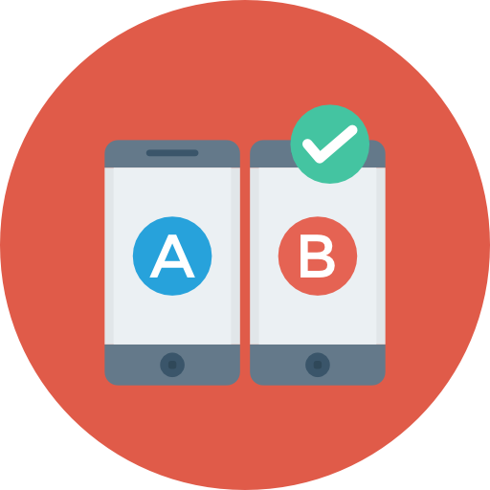

SUMMARY
We have conducted the first empirical analysis of setting defects in Android apps and found that most apps are affected by non-crashing setting defects.
Informed by the findings of our study, we designed setting-wise metamorphic fuzzing for finding setting defects, which was realized in the SetDroid tool.
SetDroid found 49 previously unknown setting defects from 26 open-source and five industrial apps, the majority (39 out of 49) are non-crashing bugs.

Slide 39
FUTURE WORK
Locate and repair the bugs detected by SetDroid.

Slide 40
FUTURE WORK
Locate and repair the bugs detected by SetDroid.
Use static analysis techniques to detect setting defects.

Slide 41
FUTURE WORK
Locate and repair the bugs detected by SetDroid.
Use static analysis techniques to detect setting defects.
Detect other non-crashing bugs.

Slide 42
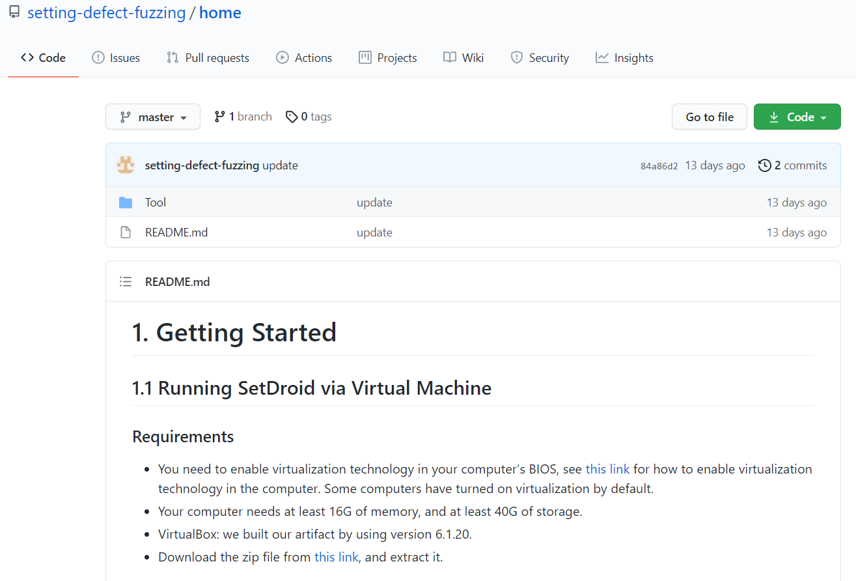
SETDROID
https://github.com/setting-defect-fuzzing/home
Video Tutorial
Documentation
Tool Extension
Study Dataset

Slide 43

EVALUATION
Setting defects found in the five commercial apps

